Slide 1
Decision Tables
Decision tables are a precise yet compact way to model complicated logic.
Decision tables, like flowcharts and if-then-else and switch-case statements, associate conditions with actions to perform, but in many cases do so in a more elegant way.

Slide 2
WHY?
Decision tables are used to lay out in tabular form all possible situations which a business decision may encounter and to specify which action to take in each of these situations.
You can use them in your projects to clarify complex decision making situations and should find them useful in your work as a computer professional.

Slide 3
Decision Tables
A decision table is a table composed of rows and columns, separated into four separate quadrants.
The upper left quadrant contains the conditions. The upper right quadrant contains the condition rules of alternatives. The lower left quadrant contains the actions to be taken and the lower right quadrant contains the action rules.
Conditions | Condition Alternatives
Actions | Action Entries

Slide 4
  Decision Table
    A decision table is a tabular form that presents a set of conditions and their corresponding actions.
  Condition Stubs
    Condition stubs describe the conditions or factors that will affect the decision or policy. They are listed in the upper section of the decision table.
  Action Stubs
    Action stubs describe, in the form of statements, the possible policy actions or decisions. They are listed in the lower section of the decision table.
  Rules
    Rules describe which actions are to be taken under a specific combination of conditions. They are specified by first inserting different combinations of condition attribute values and then putting X's in the appropriate columns of the action section of the table.

Slide 5
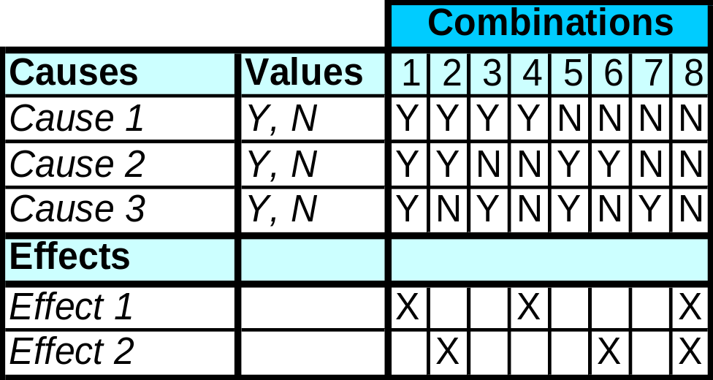
Definition
Components
A decision table lists causes and effects in a matrix. Each column represents a unique combination.
Purpose is to structure logic
Cause = condition
Effect = action = expected results

Slide 6

Application Areas
Business Analysis
Programming
Testing
Hardware Design
etc

Slide 7
Steps to Create a decision table
List all causes in the decision table
Calculate the number of possible combinations
Fill columns with all possible combinations
Reduce test combinations
Check covered combinations

Slide 8

Step 1: List all causes
Hints:
Write down the values the cause/condition can assume
Cluster related causes
Put the most dominating cause first

Slide 9
Step 2: Calculate combinations
Number of Values to the power of the number of causes with these values
If all causes are simply Y/N values:
2^{number of causes}
If 1 cause with 3 values and 3 with 2:
3¹ * 2³ = 24

Slide 10
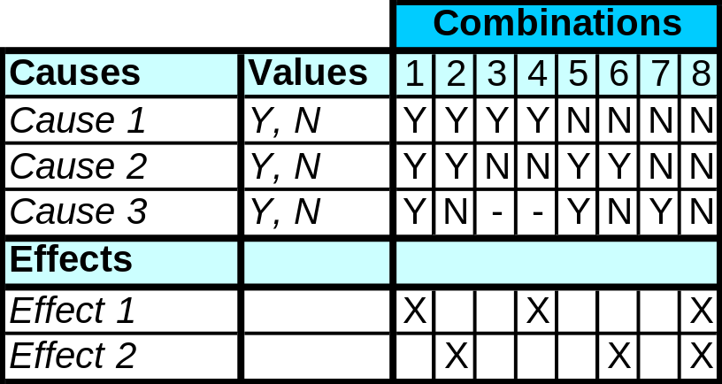
Step 3 Reduce combinations
Find indifferent combinations – place a ‘-’
Combinations
Join columns where columns are identical
Tip: ensure the effects are the same
Causes
Values
1
2
3
4
5
6
7
Cause 1
Y, N
Y
Y
Y
N
N
N
N
Cause 2
Y, N
Y
Y
N
Y
Y
N
N
Cause 3
Y, N
Y
N
-
Y
N
Y
N
Effects
Effect 1
X
X
Effect 2
X
X
X
Notes:
Often there are dependencies between causes. For example cause 1 can test if a field is entered (Y/N) and cause 2 can test if the same field is valid (Y/N). It is no use testing if the field is valid if it has not been entered.
Join columns: When in a column a cause is of no interest any more to determine the effects, a dash ‘-’ is placed in the column for that cause. This has to be done for both the column with a ‘Y’ and the column with a ‘N’. This makes the 2 columns identical and one of them can be deleted.

Slide 11
Condition 1Y Y
Condition 2Y N
Action 1X X
can be expressed as:
Condition 1Y
Condition 2-
Action 1X
The dash (-) signifies that condition 2 can be either Y or N and action will still be taken.

Slide 12
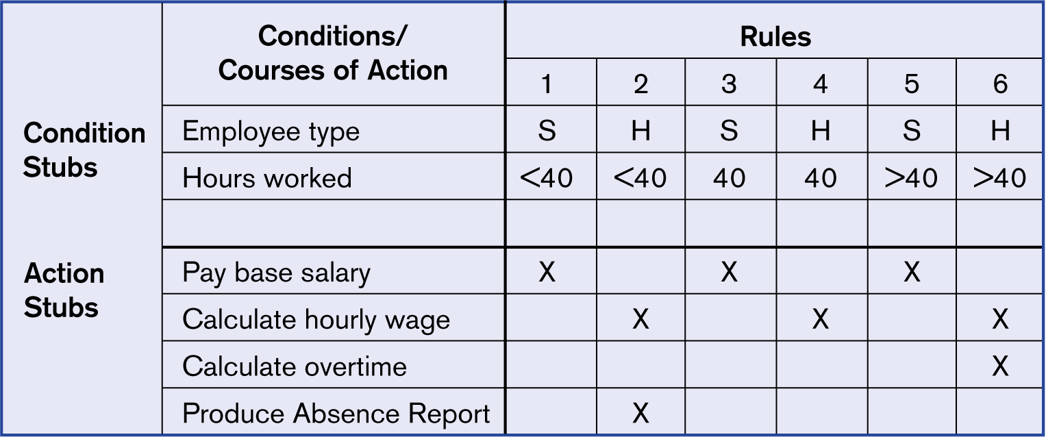
Complete decision table for payroll system example

Slide 13
A Simple Example
Scenario: A marketing company wishes to construct a decision table to decide how to treat clients according to three characteristics: Gender, City Dweller, and age group: A (under 30), B (between 30 and 60), C (over 60). The company has four products (W, X, Y and Z) to test market. Product W will appeal to male city dwellers. Product X will appeal to young males. Product Y will appeal to Female middle aged shoppers who do not live in cities. Product Z will appeal to all but older males.

Slide 14
Identify Conditions & Values
The three data attributes tested by the conditions in this problem are
  gender, with values M and F;
  city dweller, with value Y and N; and
  age group, with values A, B, and C

Slide 15
The maximum number of rules is 2 x 2 x 3 = 12

Slide 16
Identify Possible Actions
The four actions are:
  market product W,
  market product X,
  market product Y,
  market product Z.

Slide 17
Enter All Possible conditions
Rules
Proc | 1 | 2 | 3 | 4 | 5 | 6 | 7 | 8 | 9 | 10 | 11 | 12
Sex | m | f | m | f | m | f | m | f | m | f | m | f
City | y | y | n | n | y | y | n | n | y | Y | n | n
Age | a | a | a | a | b | b | b | b | c | c | c | c

Slide 18
Define Actions for each Rule
Actions
Market | 1 | 2 | 3 | 4 | 5 | 6 | 7 | 8 | 9 | 10 | 11 | 12
W | x |  |  |  | x |  |  |  | X
X | x |  | X
Y |  |  |  |  |  |  |  | X
Z | x | x | x | x | x | x | x | x |  | X |  | X

Slide 19
Full table
Rules
Proc | 1 | 2 | 3 | 4 | 5 | 6 | 7 | 8 | 9 | 10 | 11 | 12
Sex | m | f | m | f | m | f | m | f | m | f | m | f
City | y | y | n | n | y | y | n | n | y | Y | n | n
Age | a | a | a | a | b | b | b | b | c | c | c | c
Actions
Market | 1 | 2 | 3 | 4 | 5 | 6 | 7 | 8 | 9 | 10 | 11 | 12
W | x |  |  |  | x |  |  |  | X
X | x |  | X
Y |  |  |  |  |  |  |  | X
Z | x | x | x | x | x | x | x | x |  | X |  | X

Slide 20
Case Study of Book order
If order is from book store and if order is for 6 copies then discount is 25%.Else ( if order is for less than 6 copies) no discount is allowed. Else ,if order is from libraries and if order is for 50 copies or more then discount is 15%.Else if order is for 20 to 49 copies then discount is 10%. Else if order is for 6 to 19 copies then discount is 5%.Else (order is less than 6 copies) no discount is allowed.

Slide 21
Condition Stub | Condition Entry
 | 1 | 2 | 3 | 4 | 5 | 6
Customer is bookstore | Y | Y | N | N | N | N
Oder is >=6 | Y | N | N | N | N | N
Customer is Library | N | N | Y | Y | Y | Y
Order size >=50 | N | N | Y | N | N | N
Order size 20-49 | N | N | N | Y | N | N
Order size 6-19 | N | N | N | N | Y | N
Action Stub | Action Entry
Allow 25% Discount | X
Allow 15% Discount |  |  | X
Allow 10% Discount |  |  |  | X
Allow 5% Discount |  |  |  |  | X
No Discount |  | X |  |  |  | X

Slide 22
Thank You

